Slide 1
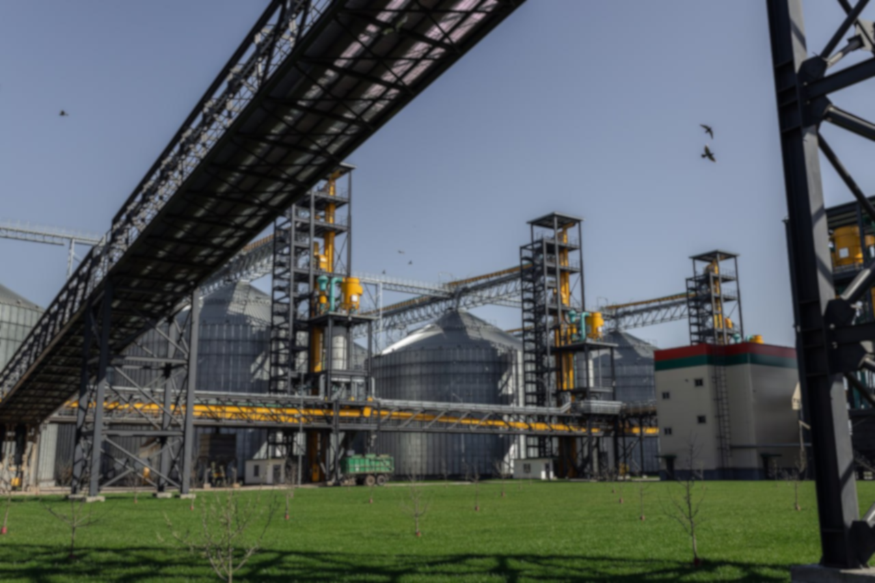
Belarusian
national
BIOTECHNOLOGY
CORPORATION
www.bnbc.by

Slide 2
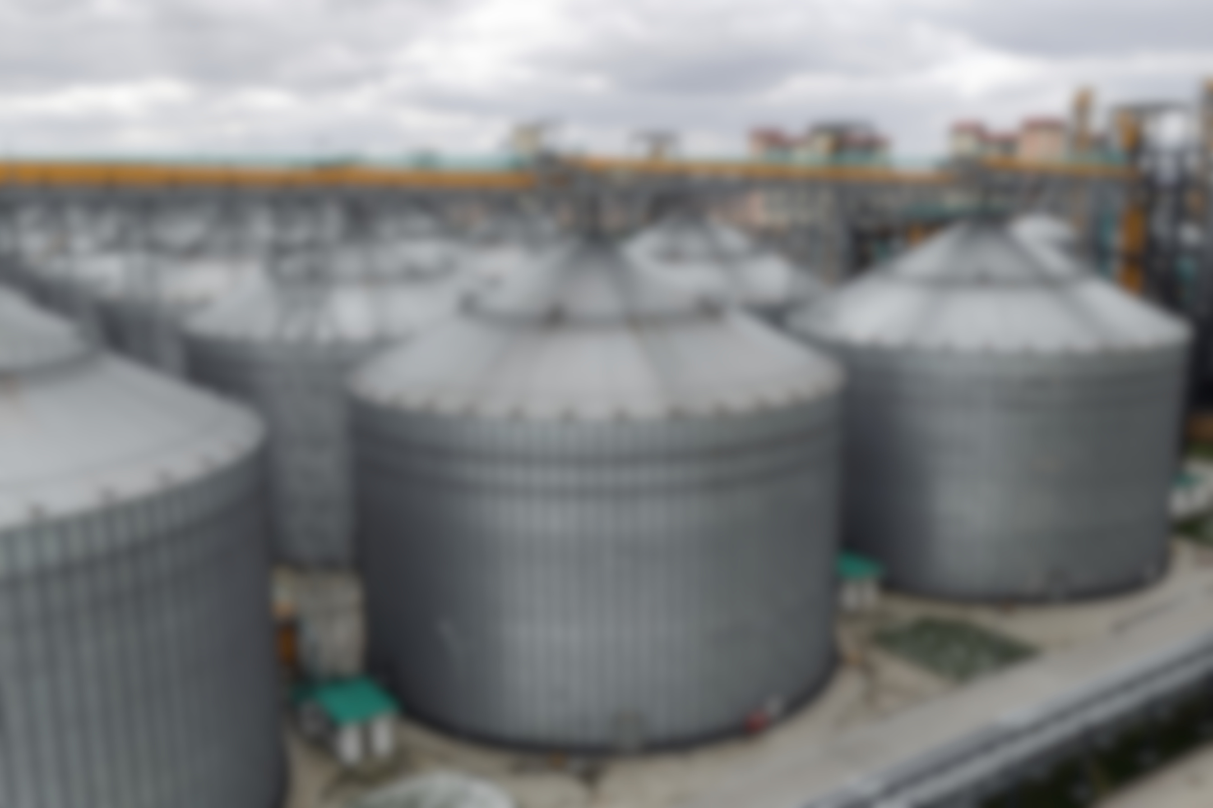
ABOUT COMPANY
Belarusian National Biotechnology Corporation–
the largest biotechnology complex in the CIS countries for the production of essential amino acids, compound feeds and premixes, wheat gluten and a number of other products of deep grain processing.
16
plants in the same technological chain
448 th. tons
600 th. tons
the volume of production of compound feeds and premixes
one-time grain storage
  Biotechnology production
  Agro-industrial production
  Infrastructure facilities
  Management of Quality Control
90 th. tons
160 ha
the volume of amino acid production
the territory of the enterprise

Slide 3

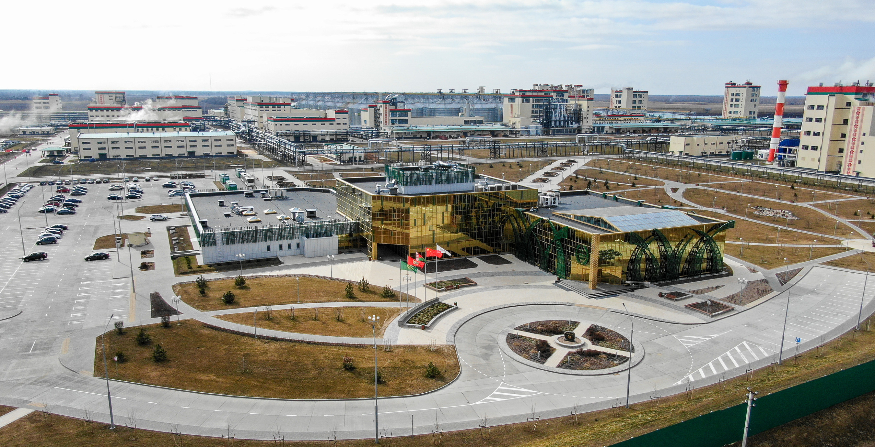
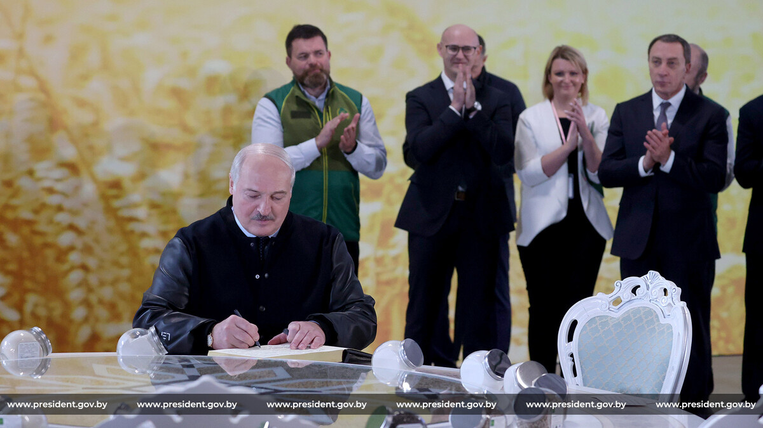
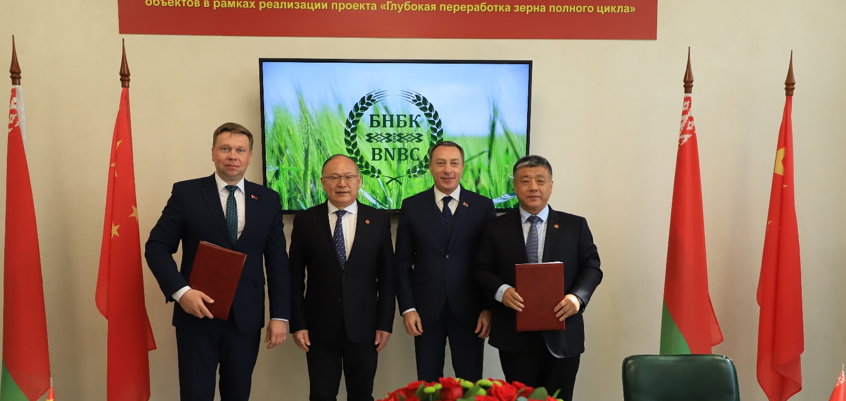
THE CHRONOLOGY
2019
-
the ceremony of laying the foundation stone and the beginning of construction
2020 -
the beginning of pilot operation of the plant complex
2022
-
the official launch ceremony by President of the Republic of Belarus Alexander Lukashenko
-
2025
signing of the general construction contract for the third stage (BNBC-3)

Slide 4
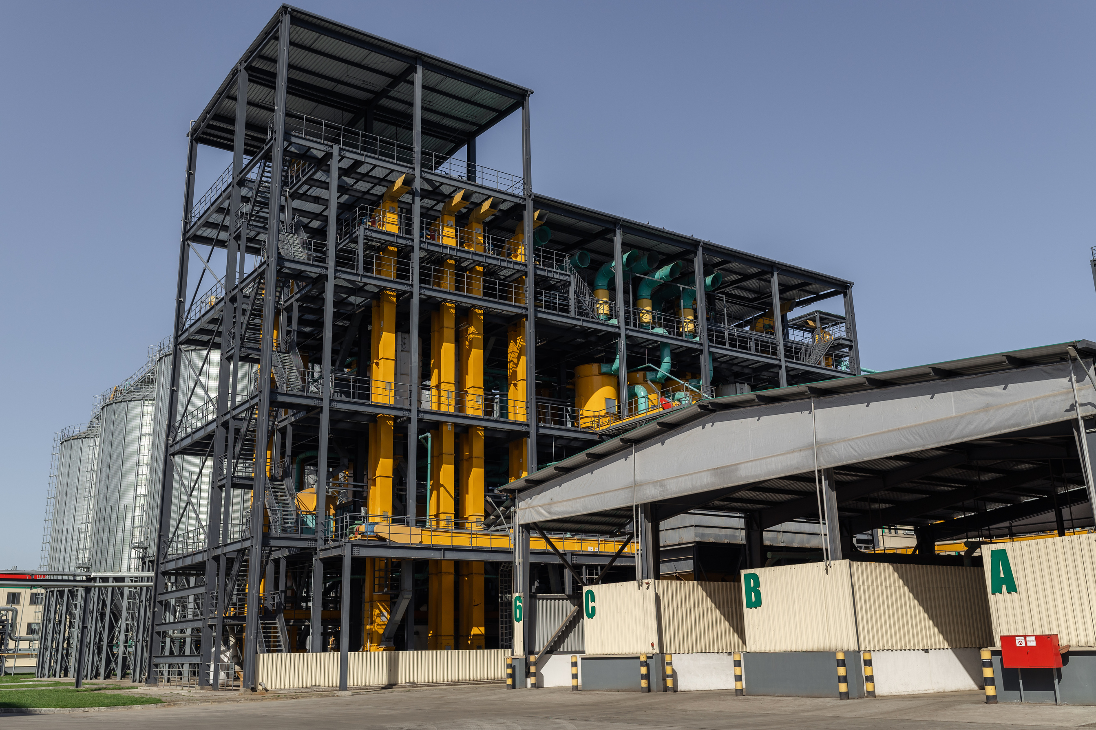

AGRO-INDUSTRIAL PRODUCTION
.
The compound feeds produced by BNBC is a high–quality product with a high conversion rate.
.
.
granary with a total volume of one-time storage of 448 thousand tons
a plant for the production of compound feeds for cattle and poultry
.
.
.
.
a plant for the production of compound feeds for pigs
a plant for the production of compound feeds for fish (including valuable species)
premix production plant
The production facilities allow us to produce food with any formulation based on the wishes of the customer and the needs of animals, taking into account the requirements of state standards and technical specifications.

Slide 5





COMPOUND FEEDS AND PREMIXES
The production can produce compound feeds in the form of loose grains, granules, and extrudate.
20 tons/hour
40 tons/hour
40 tons/hour
compound feeds for cattle
(incl. starters, prestarters)
compound feeds for pigs
(incl. starters, prestarters)
compound feeds for poultry
(incl. starters, prestarters)
13 tons/hour
20 tons/hour
compound feeds for fish
premixes for all types of compound feeds
Technological capabilities also make it possible to produce compound feeds for geese, turkeys, horses, sheep, camels, and goats.
Advantages of premix production in terms of technology:
a unique component mixing system that ensures high uniformity of the premix;
high mixing accuracy – 1:100 000;
high precision of micro component dosing with dynamic dosing – 0,2 %;
the possibility of two-stage mixing;
high homogeneity of the product, the coefficient of variation is less than 3 %.

Slide 6
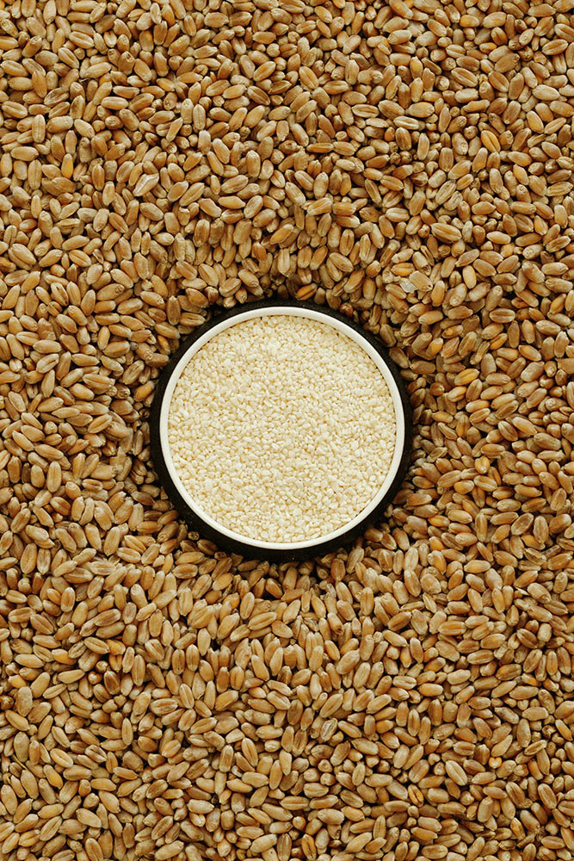
BIOTECHNOLOGY PRODUCTION
The complex consists of 16 plants integrated into one continuous production chain,
.
in which the grain, after undergoing 5 technical alterations, is converted into amino acids.
.
.
.
.
flour milling production
starch production
wheat gluten production
production of wheat product
.
.
.
.
.
.
production of glucose syrup
lysine fermentation plant
lysine extraction plant
threonine fermentation plant
tryptophan fermentation plant
.
.
.
.
tryptophan extraction plant
threonine extraction plant
ammonium sulfate production plant
production of highly refined amino acids

Slide 7
BIOTECHNOLOGY PRODUCTS
The uniqueness of the corporation lies in the fact that only here, through microbiological synthesis, four essential amino acids are produced at once: L-lysine sulfate, L-lysine monohydrochloride, L-threonine and L-tryptophan.
L-Lysine monohydrochloride 98,5 %
L-Lysine sulfate 75 %
Threonine 98,5 %
Tryptophan 98,5 %
28 th. tons/year
34 th. tons/year
5,2 th. tons/year
1,2 th. tons/year
Feed protein
(80% protein)
Wheat gluten
Wheat product
Ammonium sulfate
granular/liquid
20 th. tons/year
100 th. tons/year
5 th. tons/year
Technological advantages of using our own biotechnology products in the manufacture of compound feeds:
reducing the cost of feed products;
quality stability of raw materials components;
the ability to effectively balance the qualitative composition of feed products by protein;
ensuring high energy value of feed products;

Slide 8


GEOGRAPHY OF SUPPLIES
Import substitution:
In the territory of the Republic of Belarus, work has been established with large producers and processors of livestock products.
Export:
The geography of product supplies around the world is quite wide - Russia, Israel, India, Serbia, Bulgaria, the Republic of Poland, and the United States of America. Negotiations on the supply of products to Uzbekistan are underway.

Slide 9




INFRASTRUCTURE FACILITIES AND AUXILIARY INDUSTRIES
mini-thermal power plant
electric capacity - 25 MW; steam turbine with a steam power boiler with a capacity of 210 tons/hour
boiler plant
powered by natural gas with a capacity of 50 tons/hour
complex of sewage treatment plants
industrial wastewater treatment plants, stormwater and household sewerage
auto enterprise
about 200 pieces of equipment (automobile, tractor, buses and passenger cars)
water intake and water treatment system
railway section
14 tracks with the possibility of unloading grain, ammonia, meal, heavy and containerized cargo
mechanical repair plant and pallet production line
housing for employees
4 residential buildings with 252 apartments
canteen

Slide 10
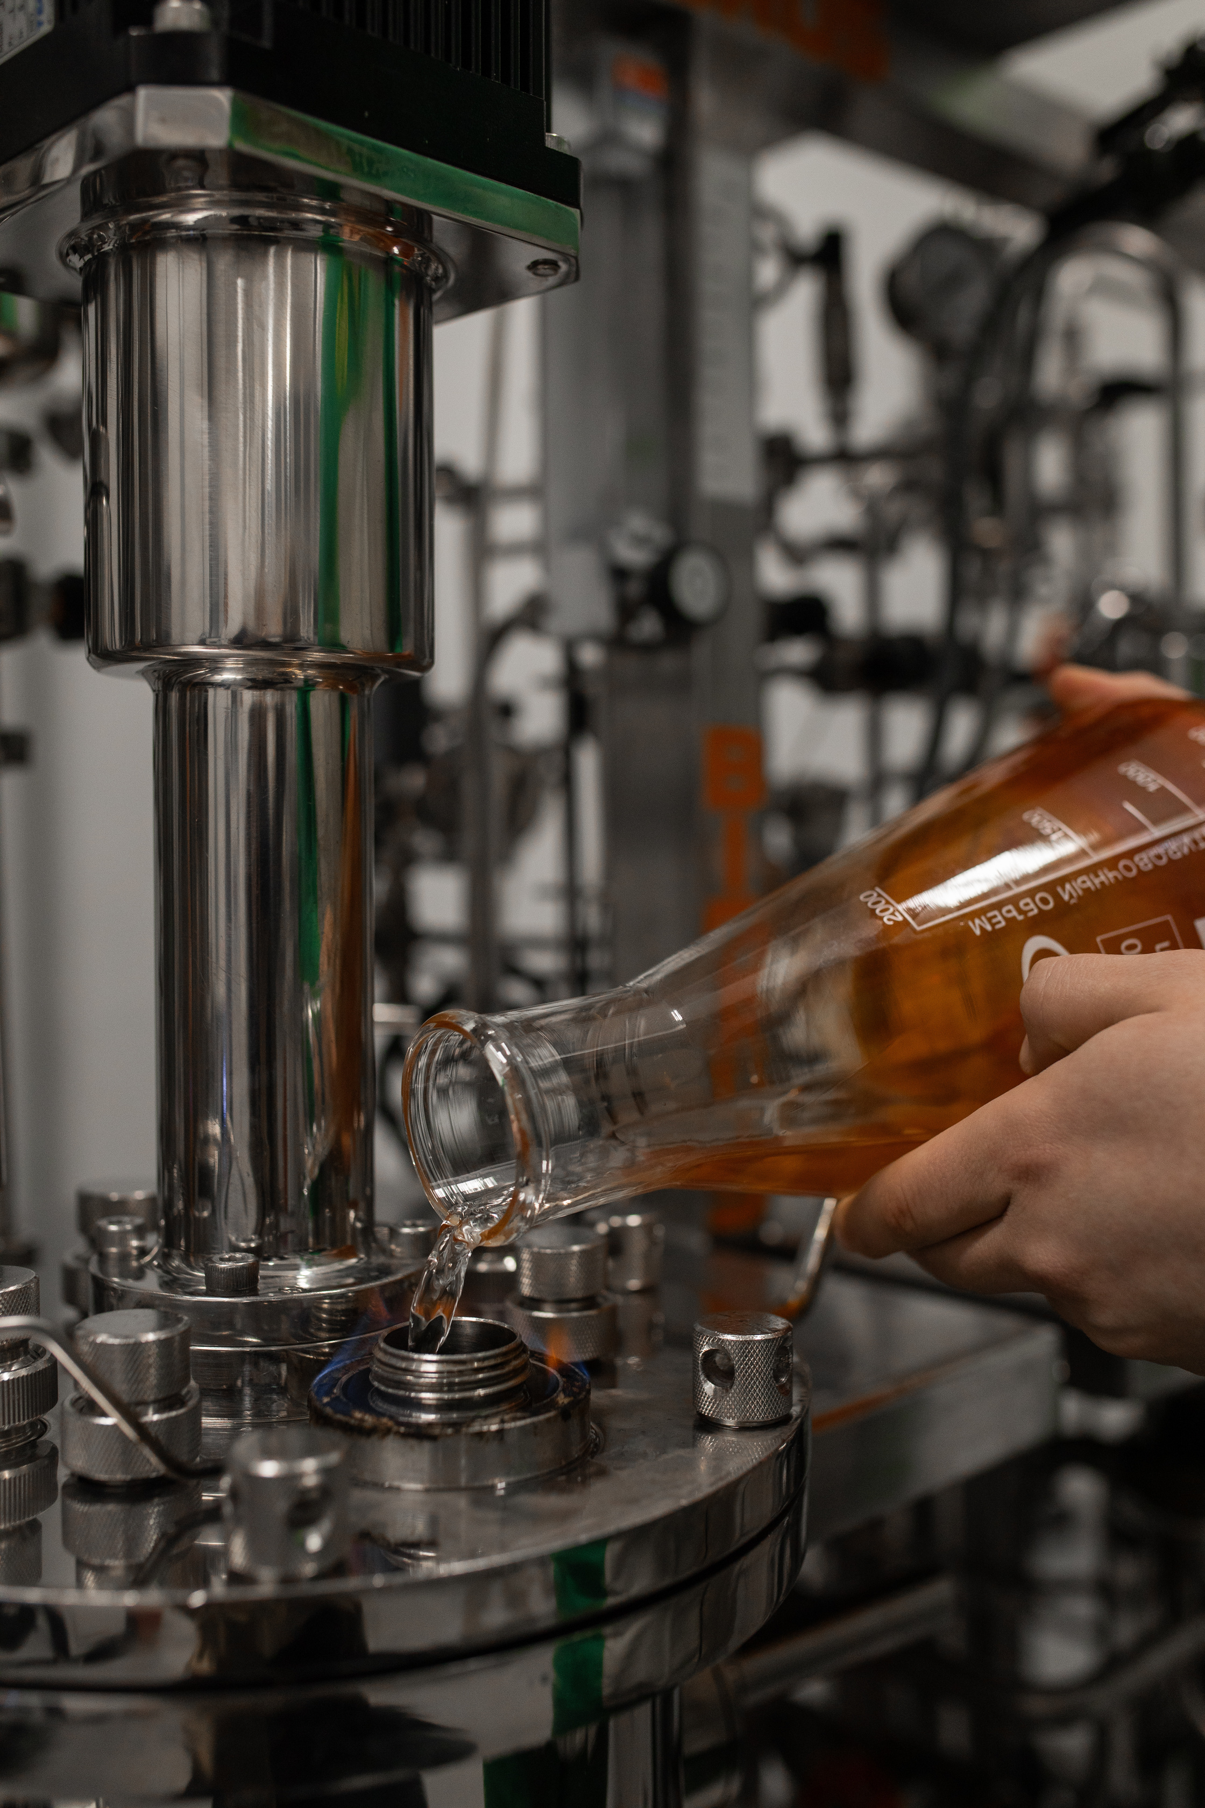


MANAGEMENT OF QUALITY CONTROL
.
agro-industrial production testing laboratory
.
.
control and testing laboratory of biotechnology production
.
quality assurance department
conformity assessment department
Main areas of activity:
multi-stage input quality and safety control of raw materials;
careful control of all stages of the production process;
ensuring and confirming the conformity of finished products with the requirements of the legislation of the Republic of Belarus and the regulatory documentation on the basis of which they are manufactured;
conducting laboratory tests of raw materials and finished products at all stages of the production process;
certification of management systems in production facilities.

Slide 11




PRODUCT CERTIFICATION
СЕРТИФИКАЦИЯ ПРОДУКЦИИ
The state registration certificates issued by the Ministry of Agriculture and Food of the Republic of Belarus have been obtained for the strains of microorganisms used in the production of amino acids.
Biotechnology production is certified according to international standards:
Agro-industrial production is certified according to international standards:
ISO 9001:2015
Kosher
Halal
STB ISO 9001-2015
An audit is expected to be conducted for compliance with the requirements of the STB ISO 9001-2015 standards.
FSSC 22000
Halal
Feed and feed additives comply with the requirements of TR 2010/025/BY and national standards.
Wheat gluten meets the requirements of TR CU 021/204.

Slide 12
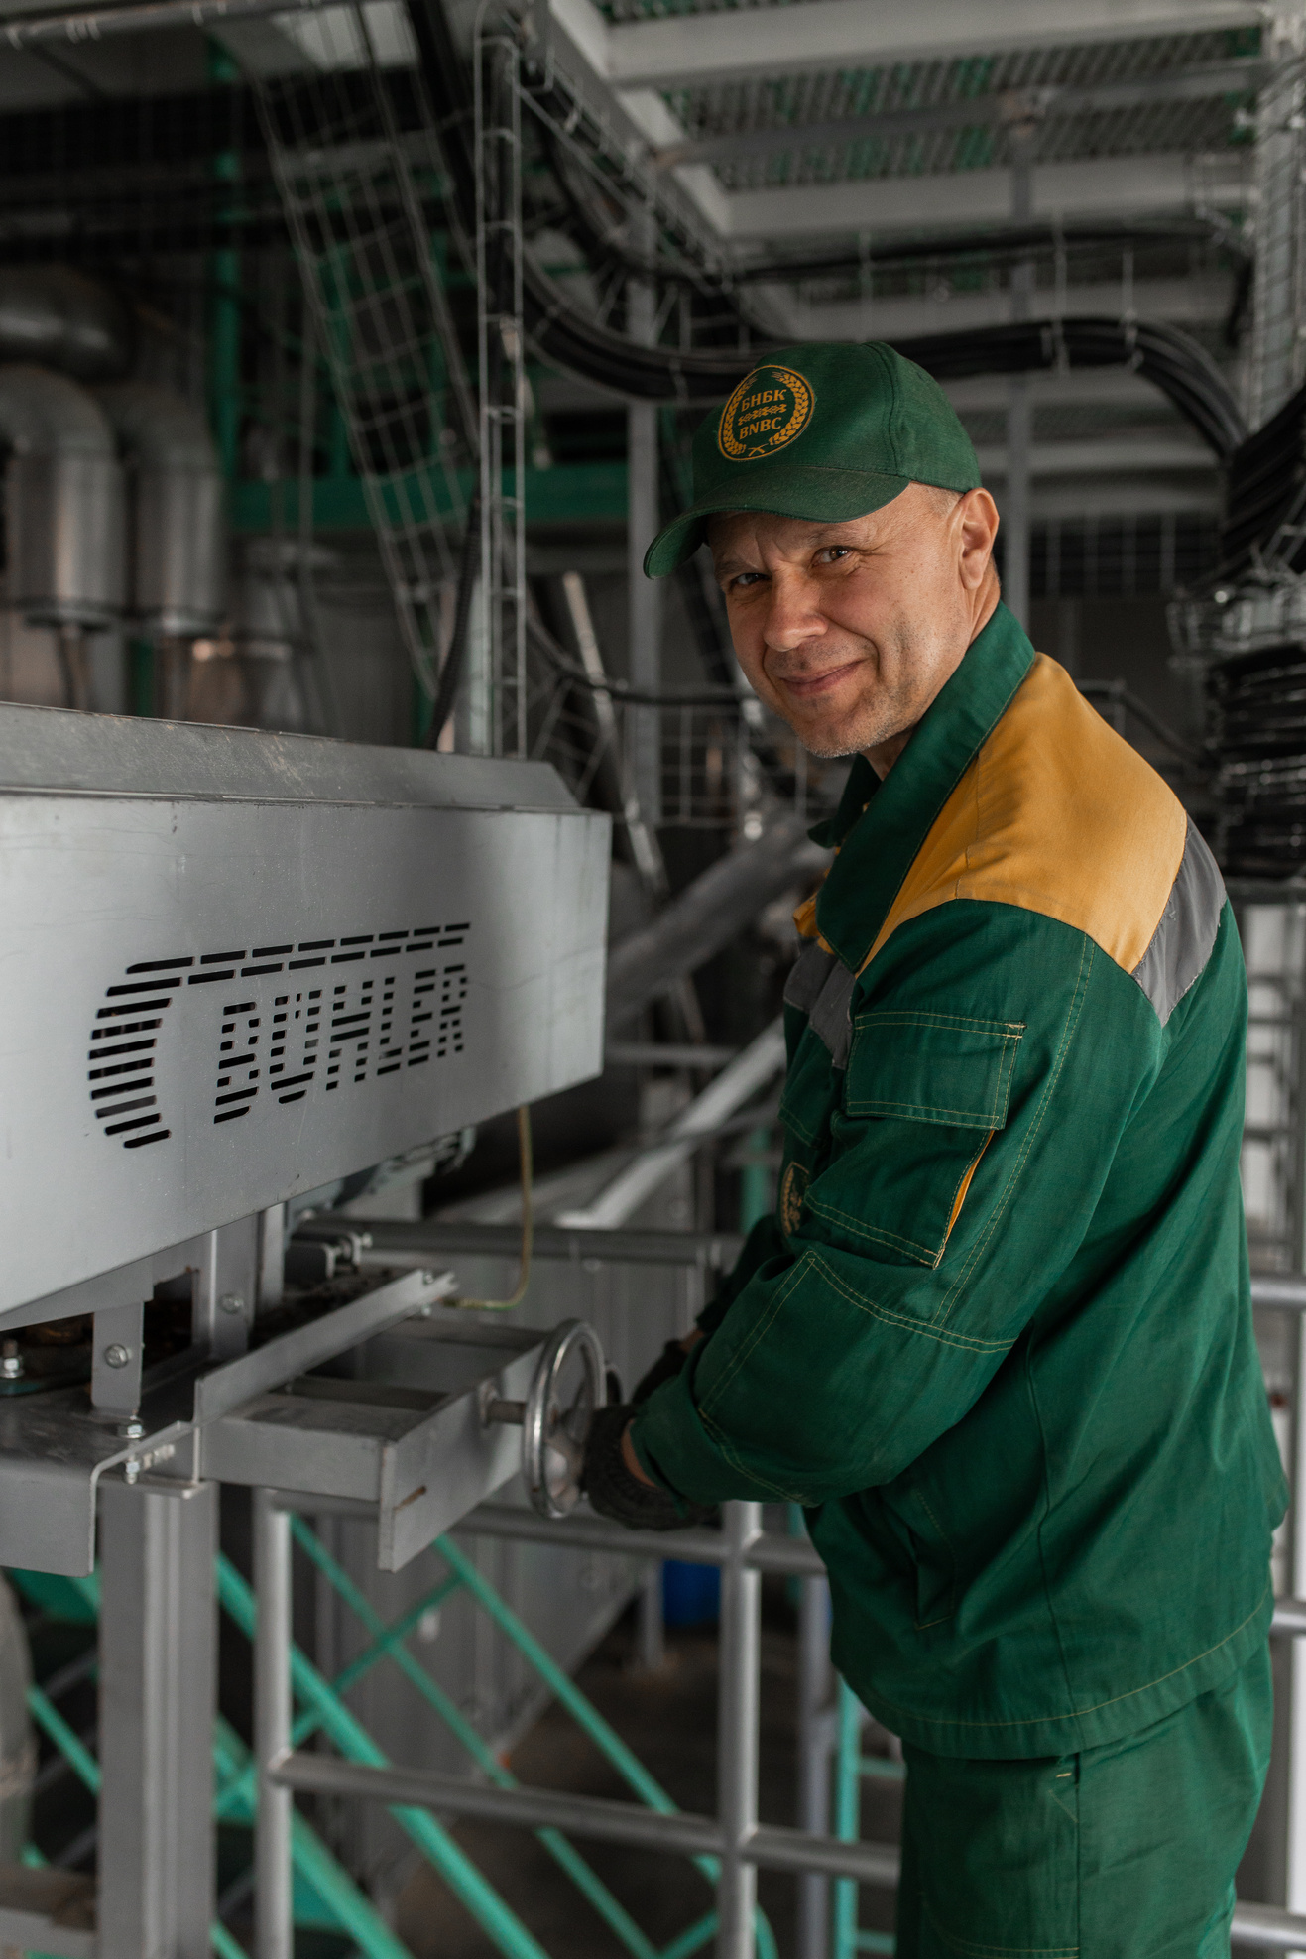


PERSONNEL AND SOCIAL POLICY
The use of advanced technologies and modern equipment is impossible without highly qualified specialists who turn available resources into real results.
The staff of BNBC is about 1,800 people.
The average age of the workforce is 37 years.
Social support:
provision of rental housing (apartment/dormitory);
free complex meals in the private canteen
delivery by official transport to the place of work and back;
other types of payments and social support.
Ideological work is carried out in the labor collective aimed at fostering patriotism, strengthening unity in society, striving for creativity, and mutual trust between the state and society.

Slide 13
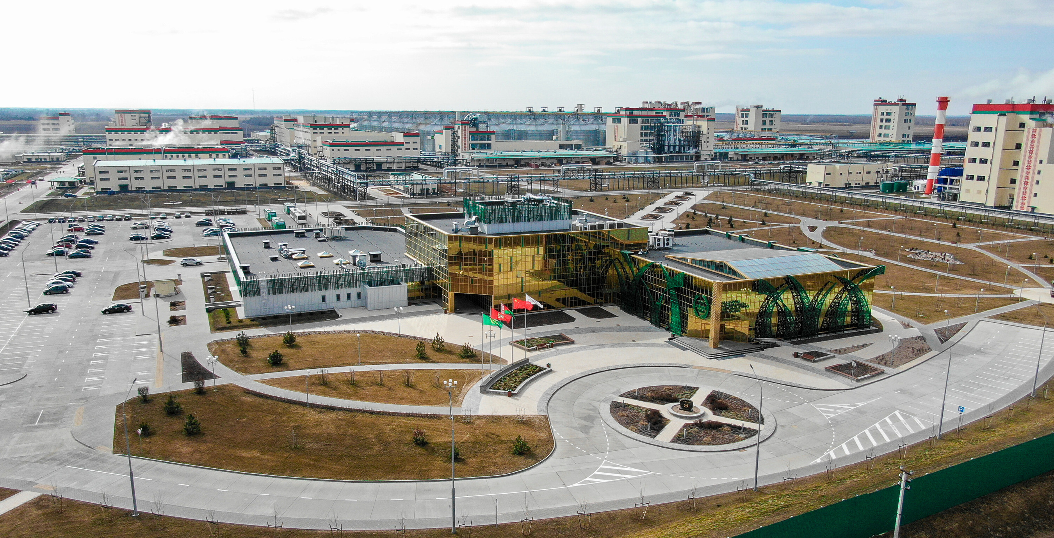

CLOSED JOINT-STOCK COMPANY
“BELARUSIAN NATIONAL
BIOTECHNOLOGY CORPORATION”
Legal/postal address:
222860, Minsk region, Pukhovichi district, Dukorsky v/s,27
Phone/Fax number:
+375 17 555 40 52/+375 17 555 40 51
E-mail: info@bnbc.by
Sales Department
E-mail: salesdepartment@bnbc.by
+375 17 134 91 31
+375 17 134 91 32
+375 17 134 91 33

